Slide 1

CAPSTONE1
University Reviews
Group: C1SE 04 2020

Slide 2

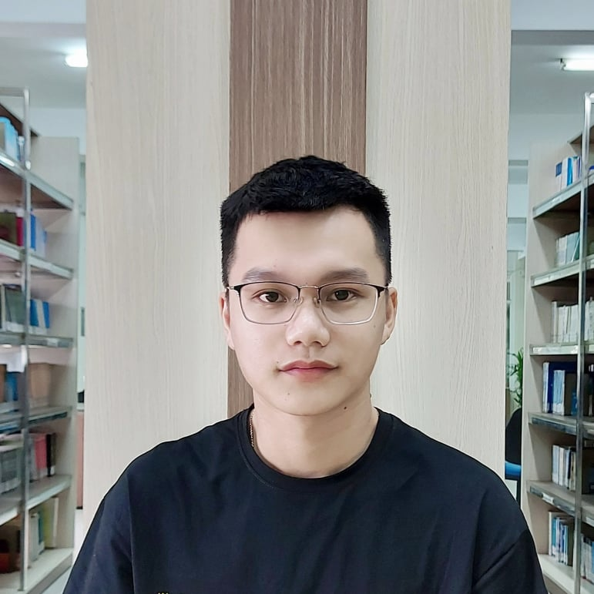
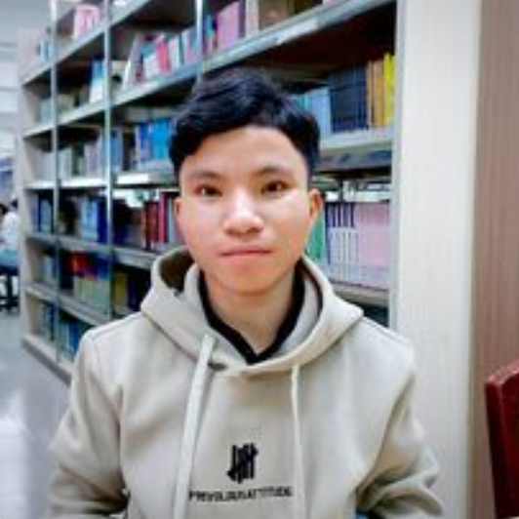

NGUYEN VAN MINH TOI Product Owner
NGUYEN HUU THIEN Master Scrum
HO XUAN SANG Team
HUYNH THI QUY THUONG Team
CAPSTONE1
Members of team
Major: Management Information System

Slide 3

Introduction to mentor
CAPSTONE1
Dr. Ha Thi Nhu Hang
Email : hanhuhangdtu@gmail.com

Slide 4
CONTENTS
CAPSTONE1
BUSSINESS ISSUSE
SOLUTION
ARCHITECTURE PROJECT
DEMO
PROCESS PROJECT

Slide 5
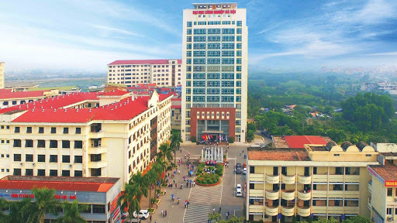

Lots of universities and students
Need a lot of interaction, and There is no suitable website to meet demand
CAPSTONE1
BUSSINESS ISSUES

Slide 6
CAPSTONE1
BUSSINESS NEED
Users need to provide detailed information about the university.
Students need the best interaction with the school and their seniors.
Users want to share their personal opinions, opinions or experiences with everyone.
Need high reliability.
Optimal in finding universities.

Slide 7

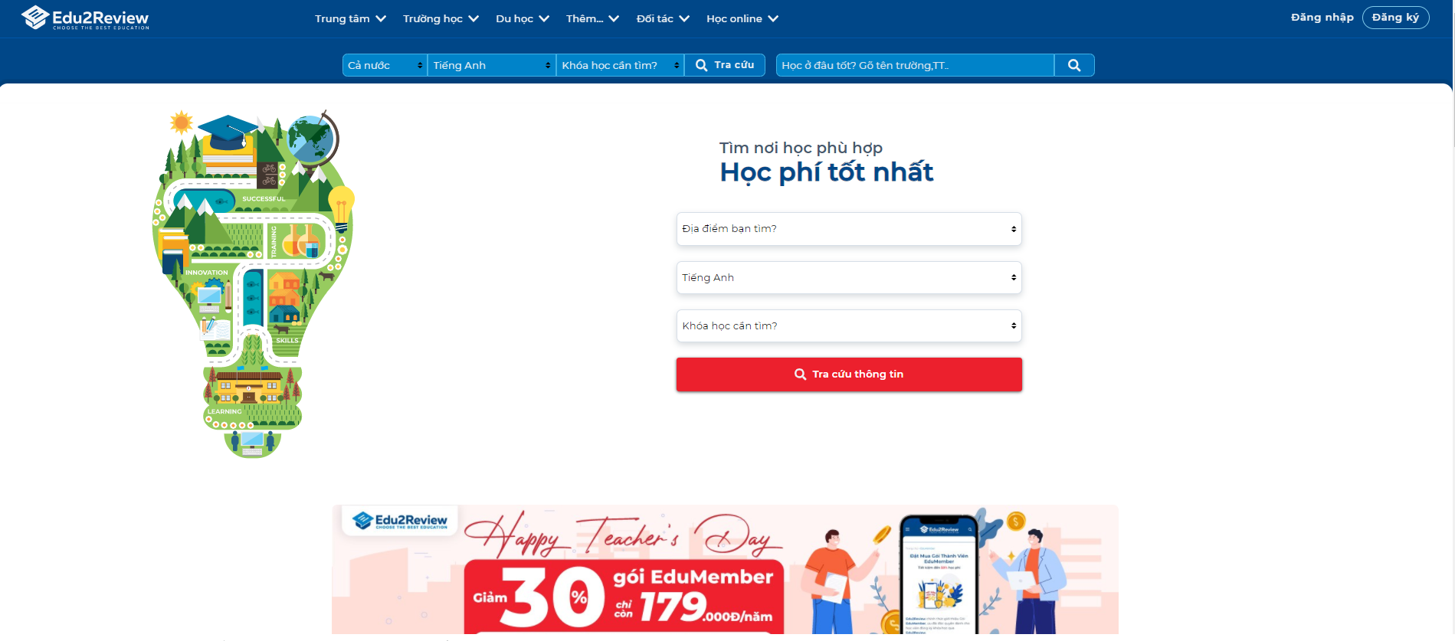
tuyensinhso
edu2review
CAPSTONE1

Slide 8

CAPSTONE1
SOLUTION
Provide all basic information University
There are topics about the school, a place to exchange and answer questions between students who have been studying at the school and candidates.

Slide 9
Who?
Admin
University
User
CAPSTONE1
Manage and control all website content
Fill their information university like their major, their infrastructure …
Watch and interact about the universities they are interested

Slide 10
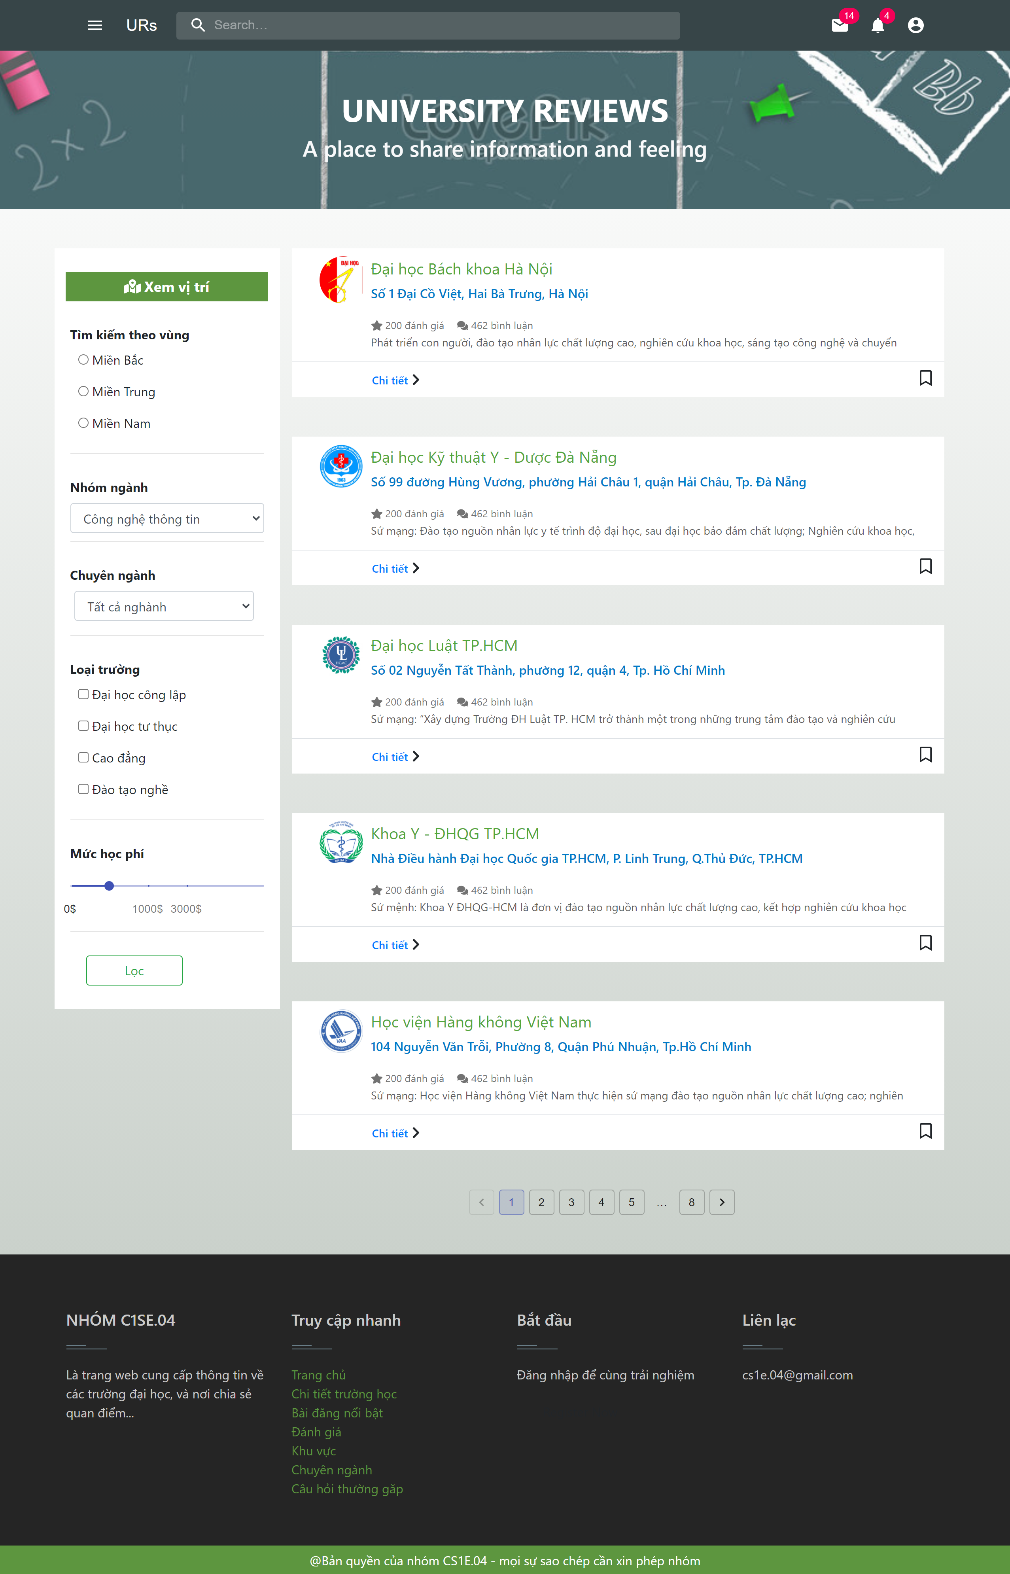
UI for user
CAPSTONE1

Slide 11
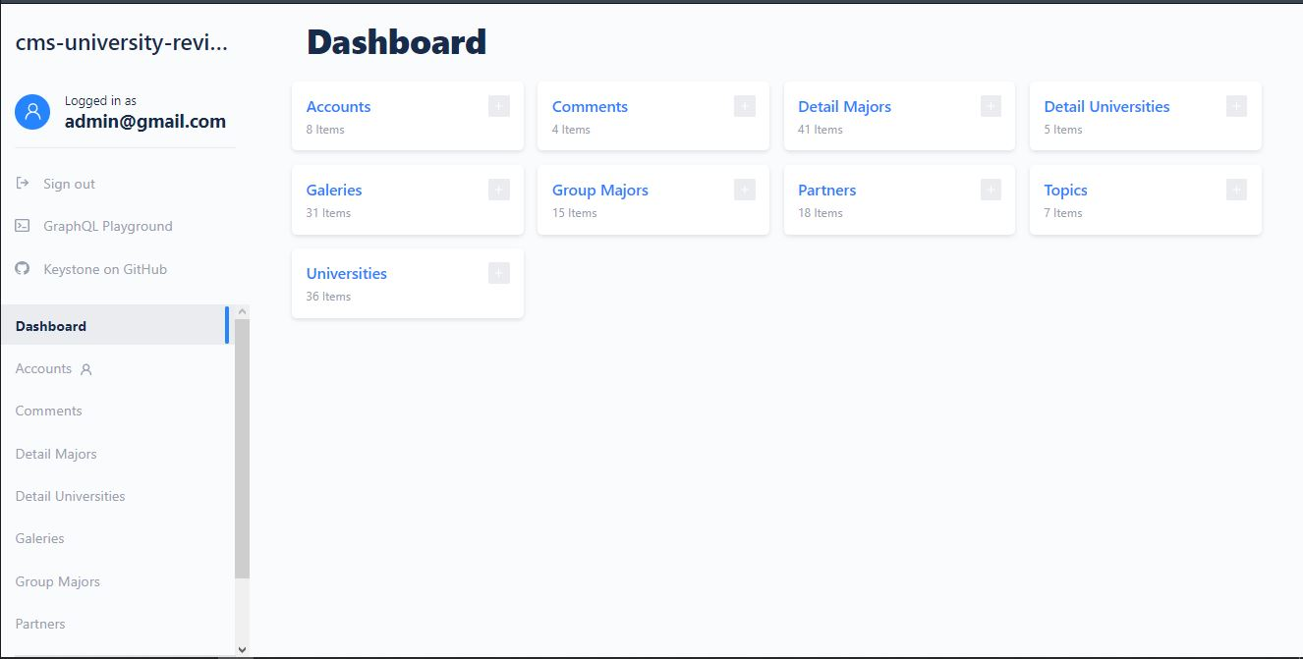
UI for Admin & University
CAPSTONE1

Slide 12
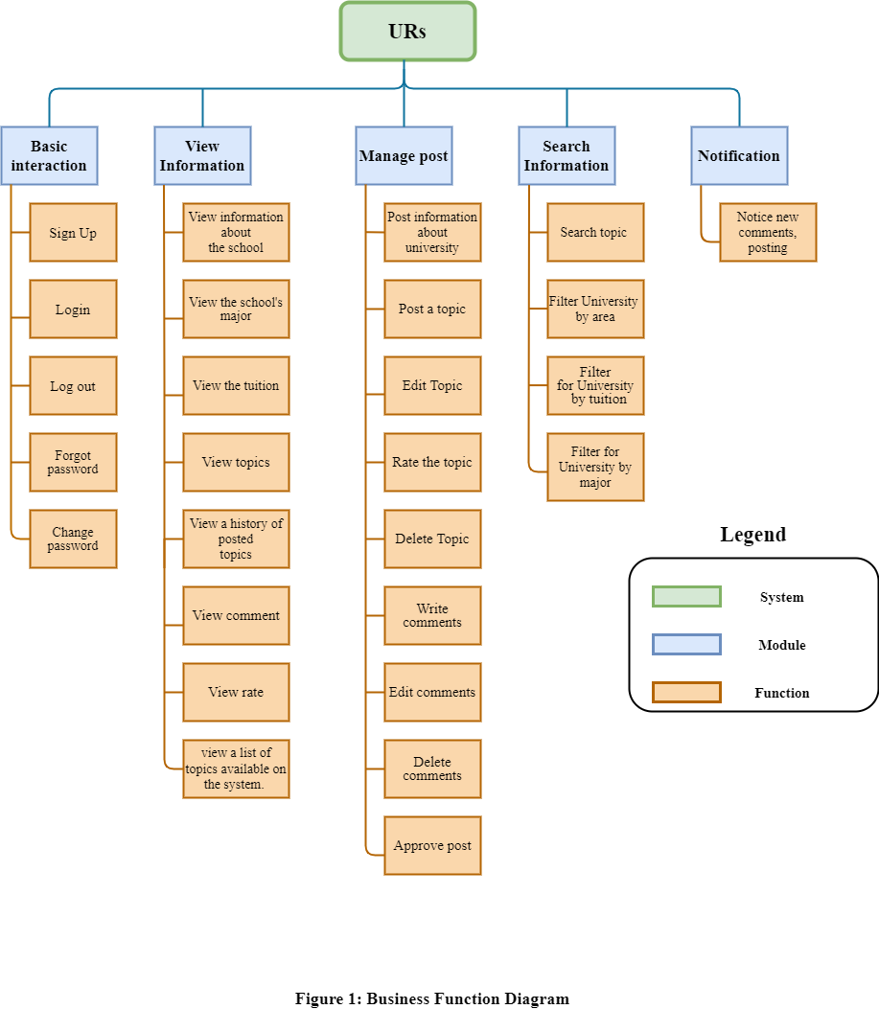
CAPSTONE1
Module Management System

Slide 13
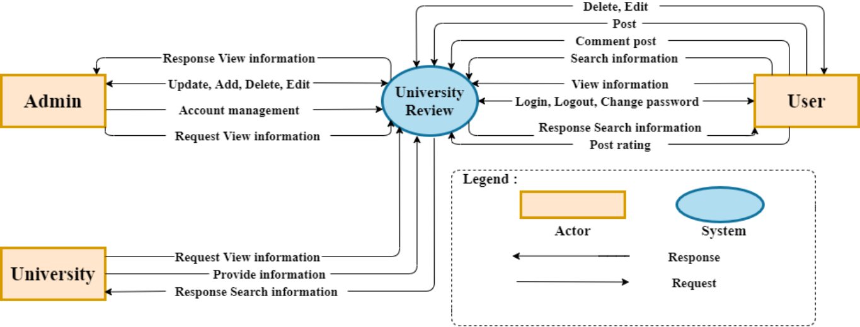
CAPSTONE1
System Context Diagram

Slide 14
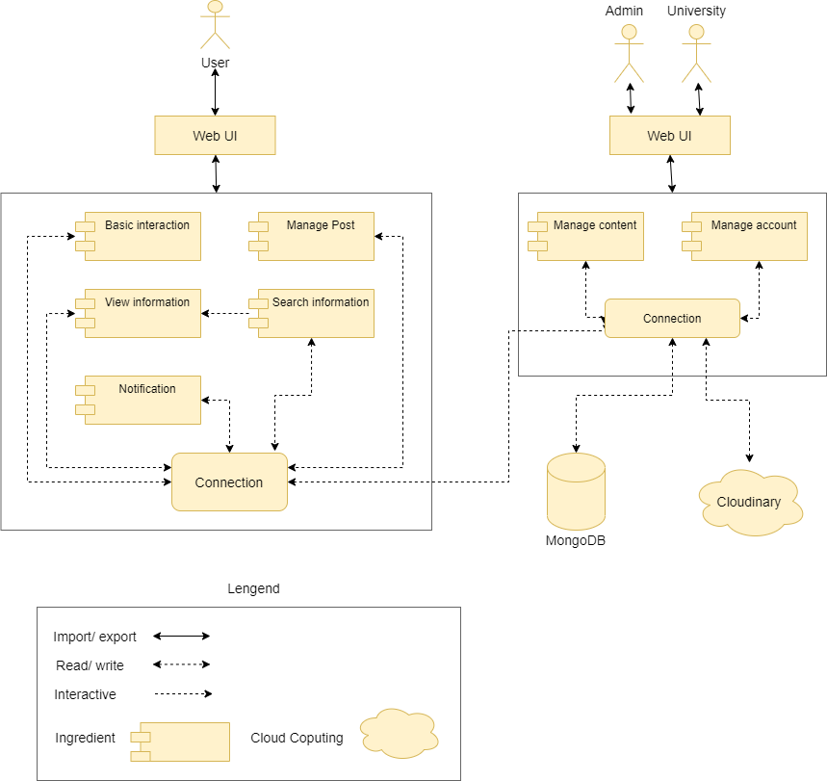
CAPSTONE1
Project Architecture
Component & connection

Slide 15
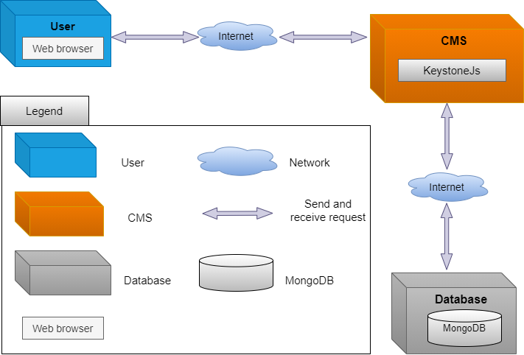
Allocation view
CAPSTONE1
Project Architecture

Slide 16
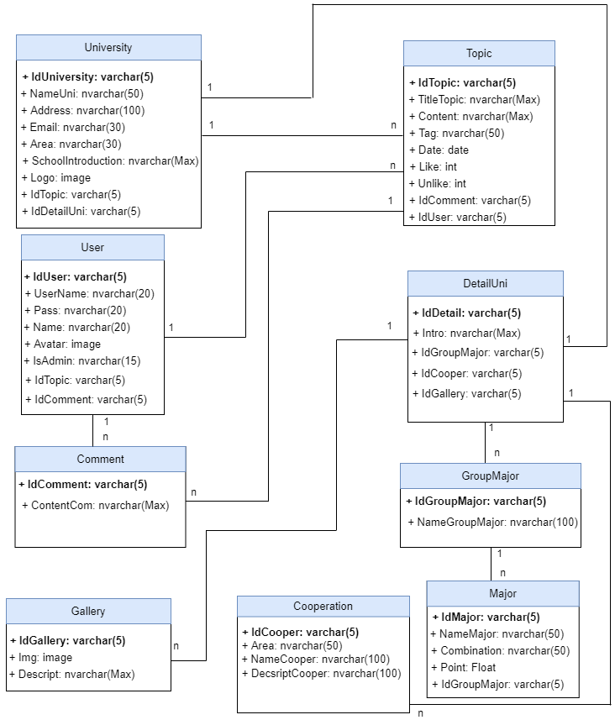
Relationship database
CAPSTONE1

Slide 17







HTML/CSS/JS
NODEJS
REACTJS
KEYSTONEJS
MATERIAL UI
MONGODB
ADOBE XD
Develop tools

Slide 18


Management tools
Trello for management work
CAPSTONE1
Github for management source code

Slide 19
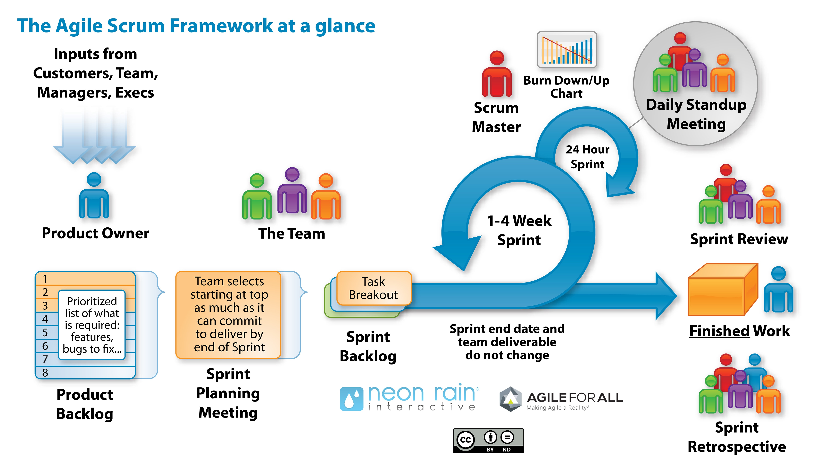
Process Model: Scrum Process
Process model
CAPSTONE1
Scrum is an iterative and incremental agile software development framework for managing software projects and product or application development.

Slide 20
PROJECT PROCESS
CAPSTONE1
ONE
TWO
THREE
FOUR
SPRINT 1
SPRINT 2
SPRINT 3
SPRINT 4
Start day: 29/08/2020 End day: 25/09/2020
During: 28days
Start day: 25/09/2020 End day: 22/10/2020 During: 28days
Start day: 22/10/2020
End day: 11/11/2020
During: 21days
Start day: 11/11/2020
End day: 01/12/2020
During: 21days

Slide 21
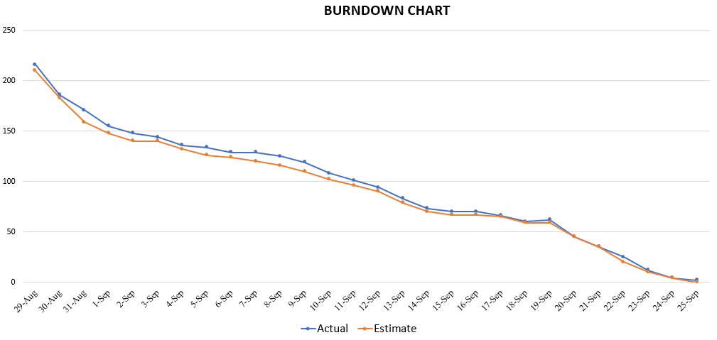
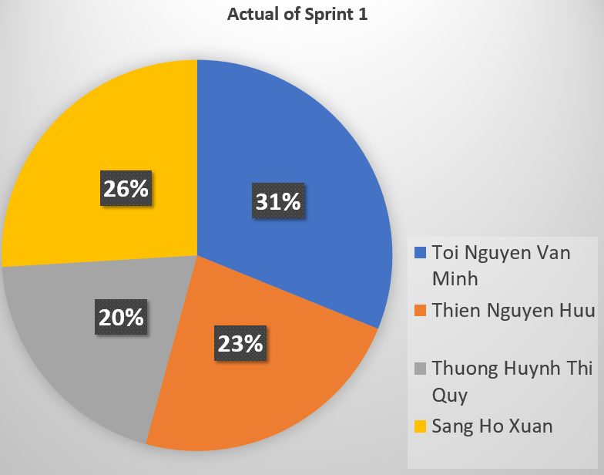
Sprint 1: Burndown Chart
CAPSTONE1
Chart dividing the actual working time of each member
Burndown Chart Sprint 1

Slide 22
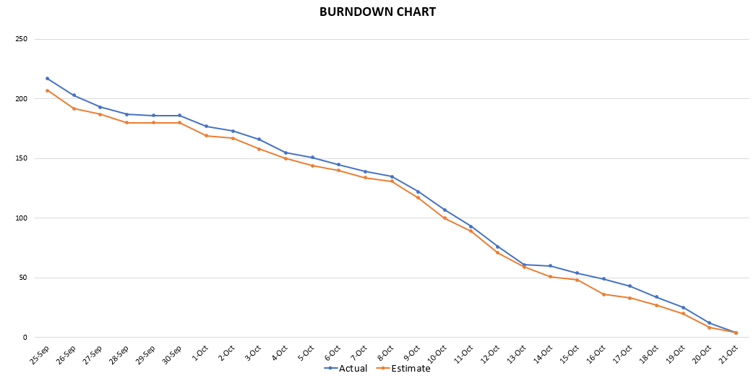
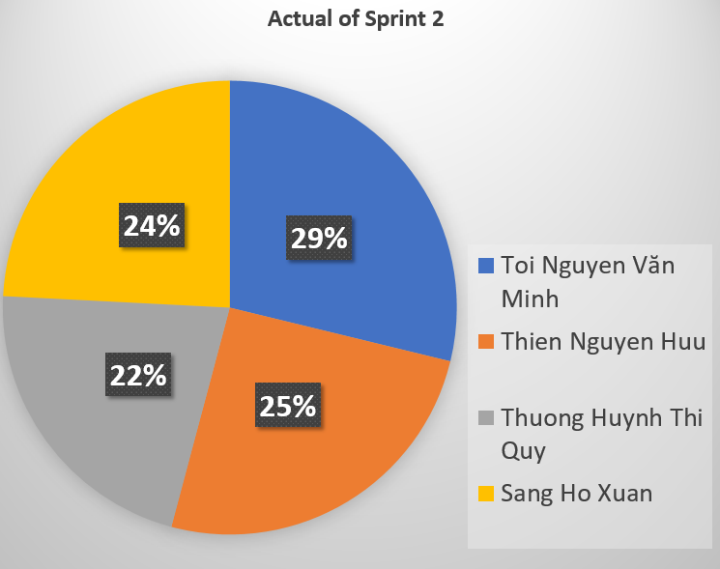
Sprint 2: Burndown Chart
CAPSTONE1
Chart dividing the actual working time of each member
Burndown Chart Sprint 2

Slide 23
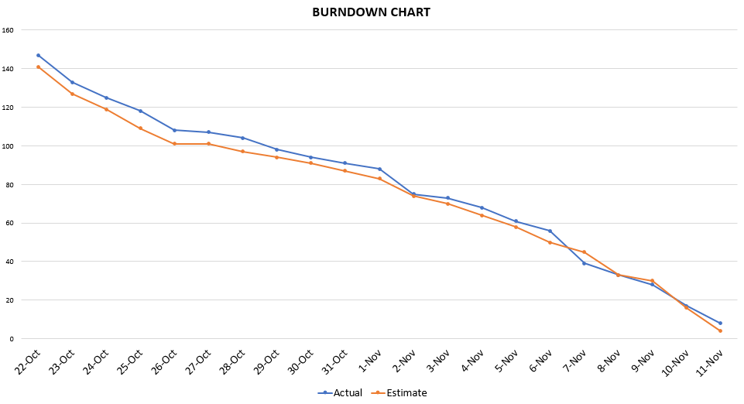
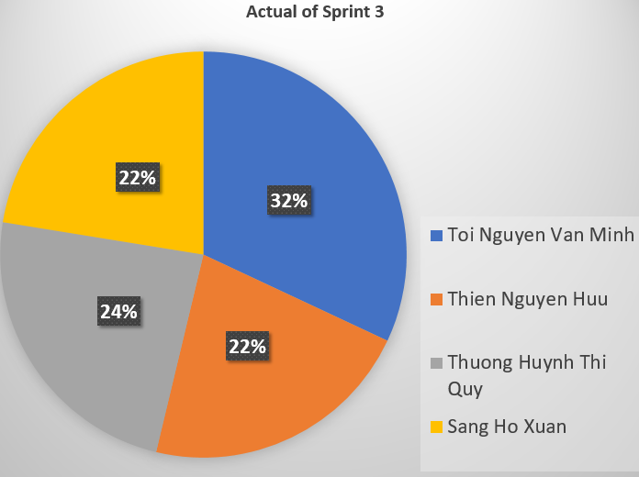
CAPSTONE1
Sprint 3: Burndown Chart
Chart dividing the actual working time of each member
Burndown Chart Sprint 3

Slide 24
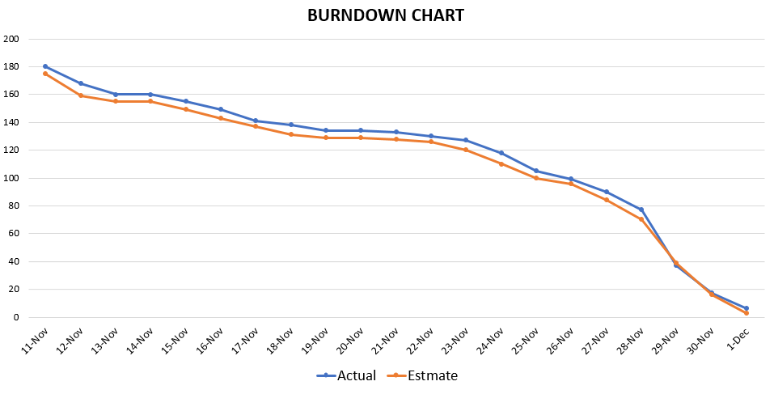
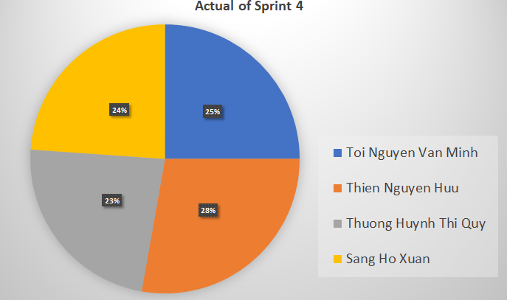
Sprint 4: Burndown Chart
CAPSTONE1
Chart dividing the actual working time of each member
Burndown Chart Sprint 4

Slide 25



RISKS AND EVALUATION
RISKS:
WELL DONE:
NOT GOOD:
CAPSTONE1
Not much experience of technical.
Group self coding does not use the template
Good interaction, each member is responsible
Understand each other, easy to agree with each other at work.
Arrange working time together easily
Relatively on time
Lack of experience in project management.

Slide 26
CONCLUSION
COMPLETE :
LEARNING:
DIFICULT :
100% Complete the planned task.
New technology.
Teamwork.
Improve process.
Get a lot of experience in project management and product making.
Manage time.
Learning new technology while working on projects.

Slide 27

CAPSTONE1
PRODUCT DEMO

Slide 28
THANKS for listening
Does anyone have any questions?

